Slide 1
Three requirements the Analyst Must Meet
Business Intelligence & Analytics

Slide 2
Three requirements
Business competencies
Tool kit that is in order (method competencies)
Technical understanding (data competencies)

Slide 3
Business competencies
Understand the business process he or she is supporting and how the delivered information/knowledge can make a value-adding difference at a strategic level.
The business needs a clear strategy that is communicated to the analyst. The analyst needs to make sure analysis considers company strategy.
The analyst understands and is able to convey the potential of using information as a competitive parameter
The analyst needs to be a good communicator and how to leverage results to benefit the business
Understand the business process he or she is supporting and how the delivered information/knowledge can make a value-adding difference at a strategic level.
The analyst needs to have a close relationship with the business units supported. The business unit needs to trust the analyst.

Slide 4
Business competencies
The analyst needs to have or be given a fundamental business insight in relation to the deliveries that are to be made.
Results that do not relate to business action or understanding are of no use to the business.
The analyst must be able to optimize deliverables in such a way that the user is given the best possible decision support.
Audience needs to be considered carefully when providing results to the business.
The analyst needs to be capable of having a continual dialogue with the business, as well as of detecting and creating synergies across functions.
Analysts need to have a close relationship with the business units they support. Analysts across functions need to keep in close contact

Slide 5
Tool kit (methods)
Data Visualization
Data Visualization
Often a requirement to visualize information so that the user gets an overview of results.
Statistical Methods
Need users to derive the correct insight from the information being provided.
Must know which test to use and when (will often need to look up details)
Statistical Software
Analysts should not define themselves based on their knowledge of a specific software package.
Most analytical software provide the same functions in slightly different ways.
Most analytics software are compatible with one another.
Most important: extract the right insight.

Slide 6
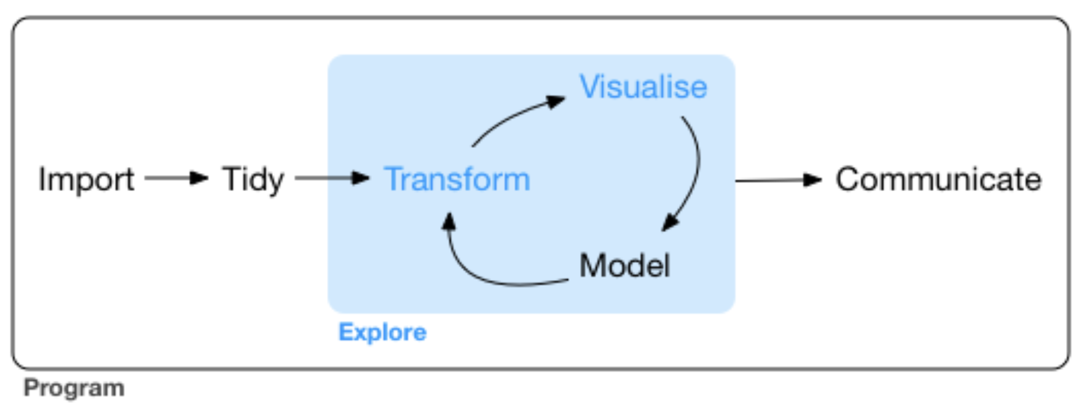
Technical understanding (Data)

Slide 7
Technical understanding (Data)
80% of the analysts time

Slide 8
Business Competencies: understanding and communicating with the business
Tool Kit: know which statistical methods to use and when
Technical understanding: get data from systems and prep it for analysis
Need these capabilities in the team (not necessarily in every individual

Slide 9


